Slide 1
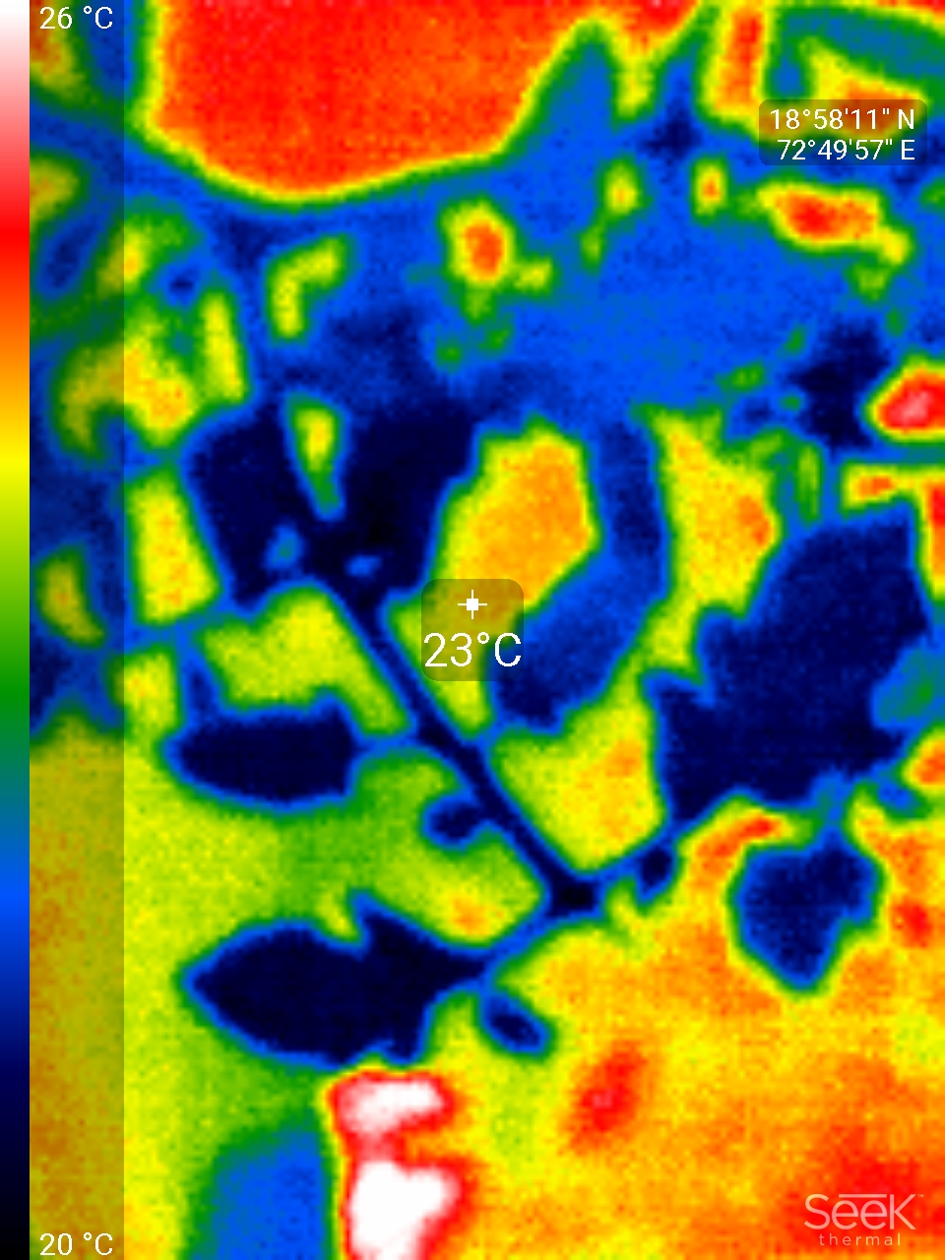
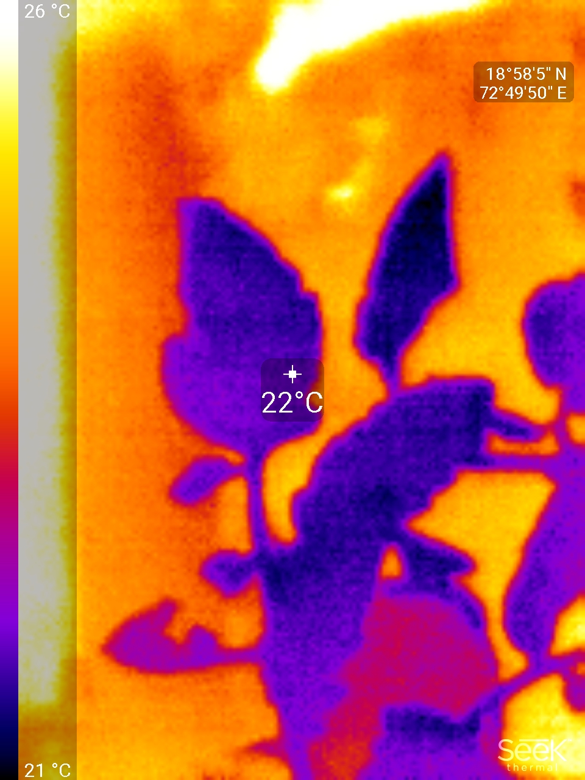
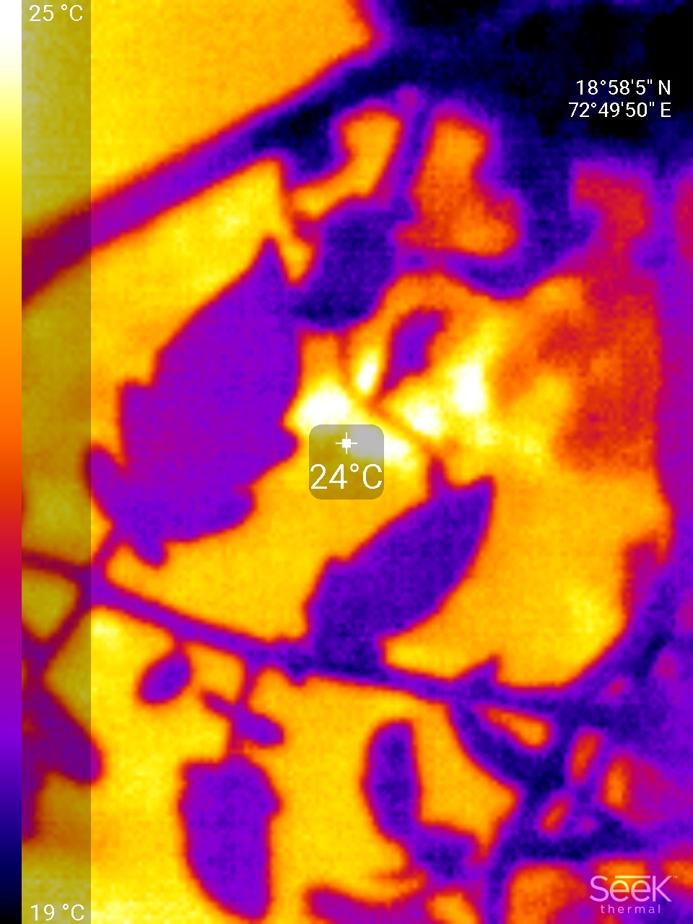
Stress Detection using Thermal Images

Slide 2
1
Agriculture
6
Deep learning Deep Learning
2
Global Warming
Motivation
5
Multimodal analysis
3
Water Scarcity
4
Thermal imaging

Slide 3
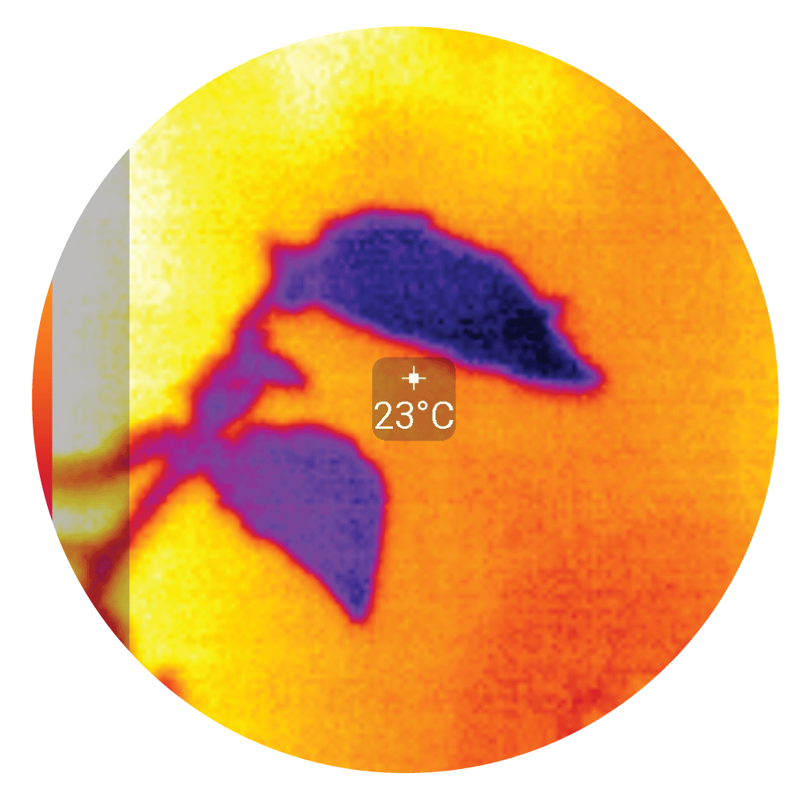
Thermal Images
6
1
Wide Applications
Heat Sensor
Temperature Readings
5
2
Infrared radiation of object
Cold and hot region
See the unseen
4
3

Slide 4
Types of Stress
01
02
Biotic
Abiotic
Biotic stress are the ones which cause damage to plants via living organisms, including fungi, bacteria, insects and weeds.
May cause disease
Abiotic stress affects the plants cells in the form of water stress, temperature stress, wind stress and many more.
May or May not cause disease

Slide 5
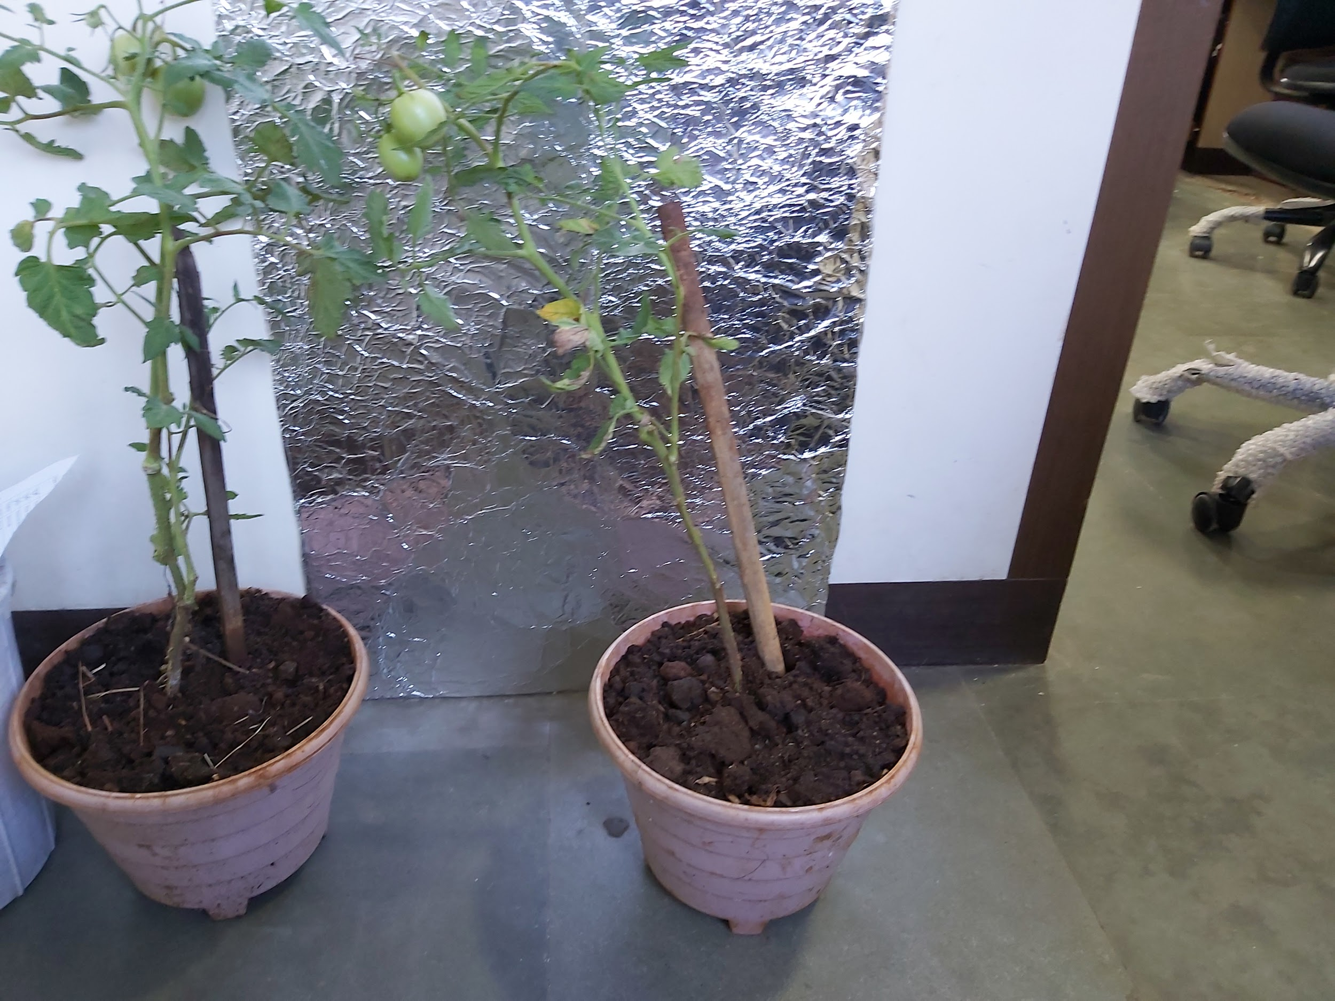
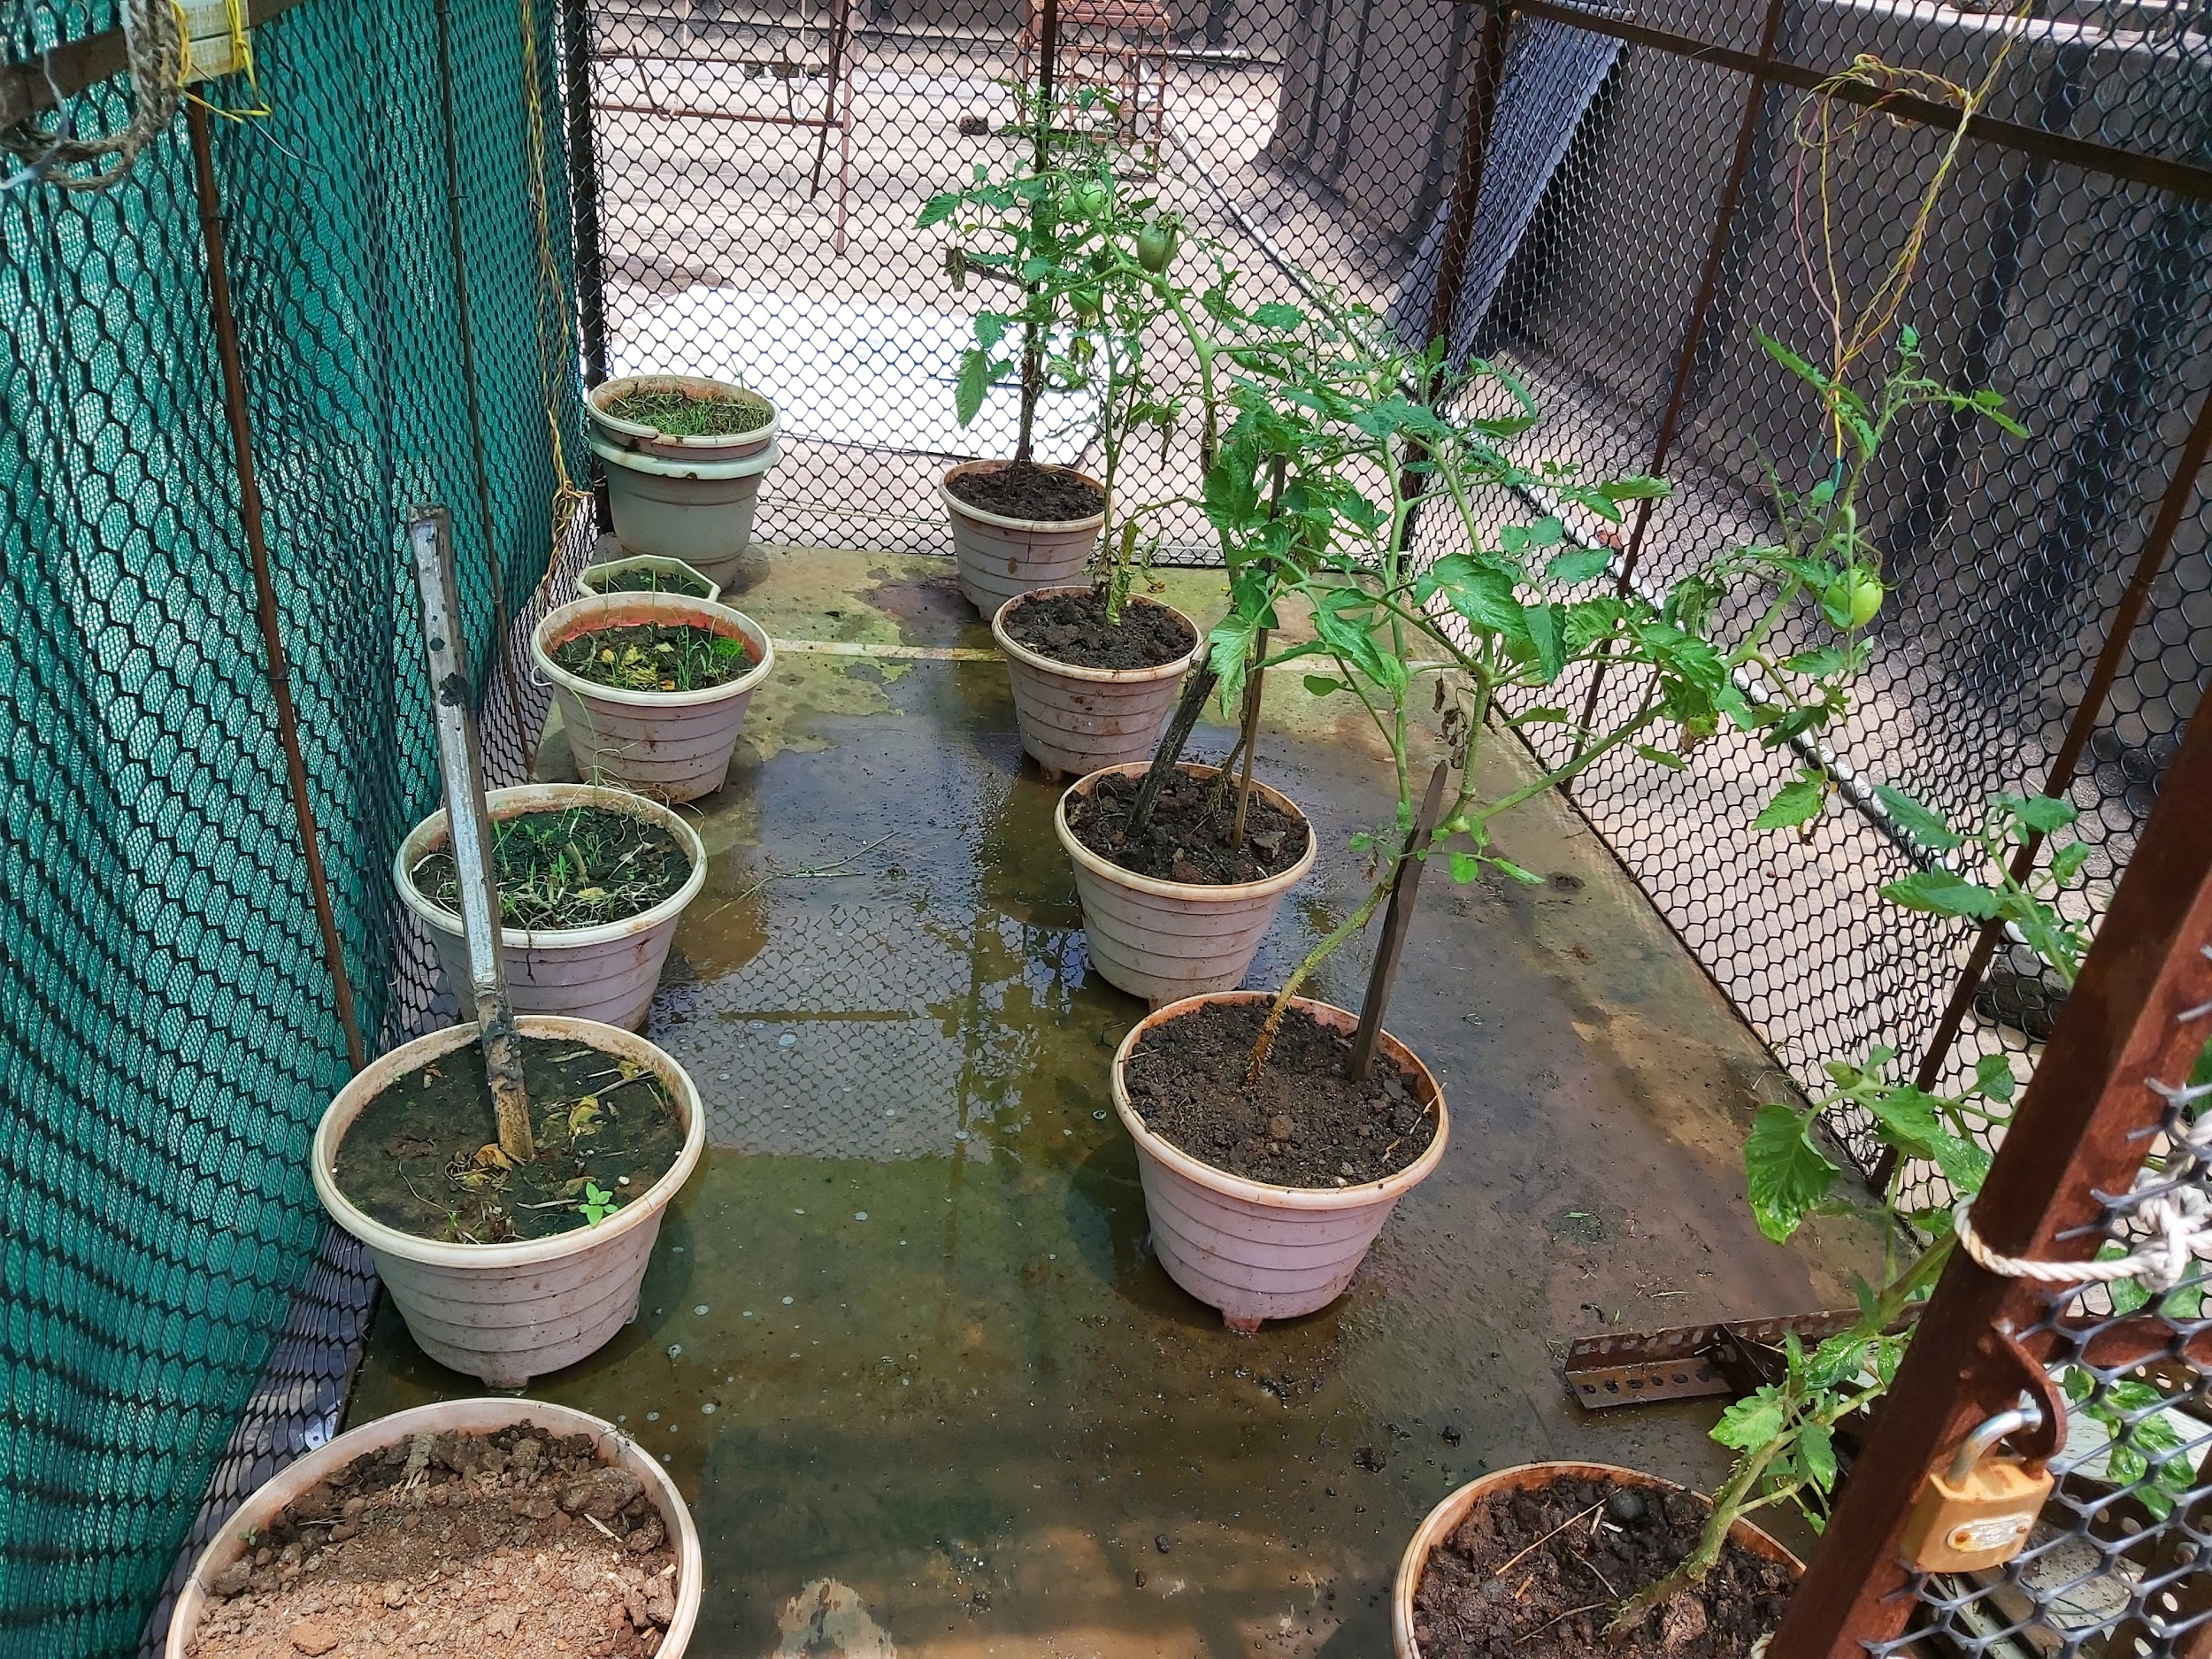
Data Collection
Controlled Environment
Normal Environment
Days collected- 20
1 Stressed tomato plant
1 non-Stressed tomato plant
Days collected- 45
1 Stressed tomato plant
2 non-Stressed tomato plants
Thermal camera image filter- Iron and IR filter.
Three types of temperature values taken: Tcanopy, Twet and Tdry.
Daily thermal images of plants:- stressed and non-stressed

Slide 6
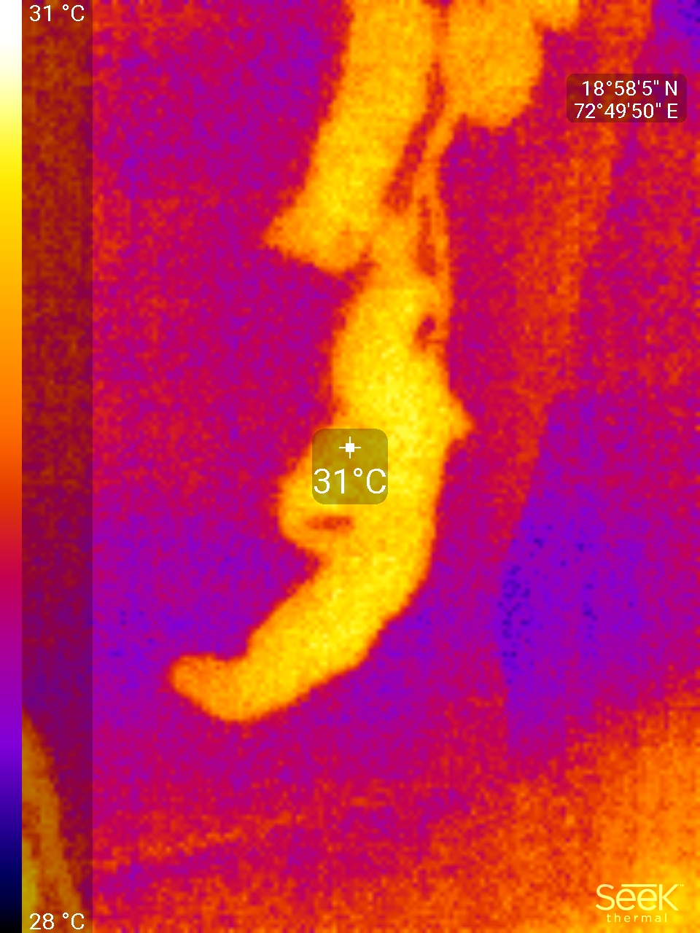
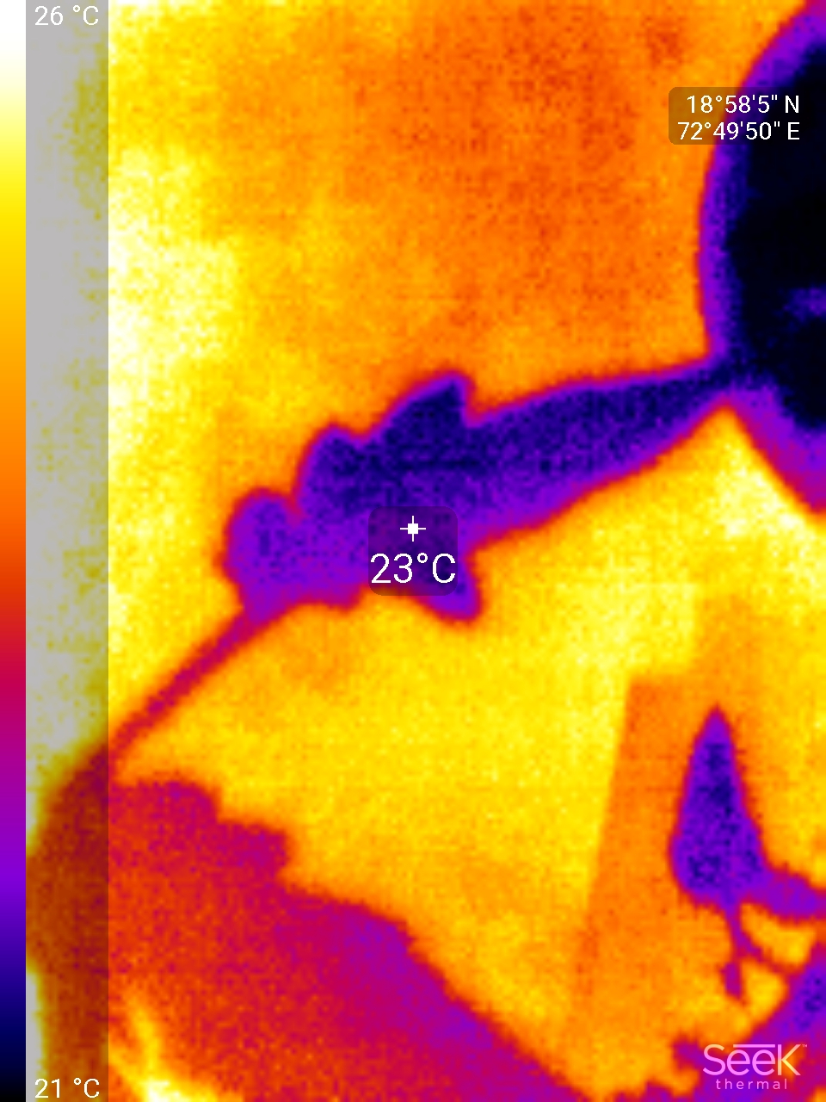
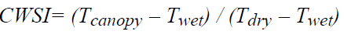
Image Data
STRESSED
NON-STRESSED
CWSI Range- 0.7-1
Temperature of leaf is high
CWSI Range- 0-0.6
Temperature of leaf is in normal range.
80%
40%

Slide 7
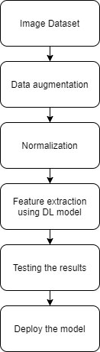
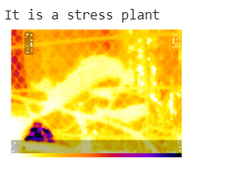
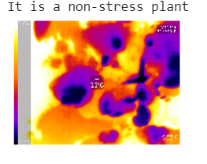
Deep Learning

Slide 8
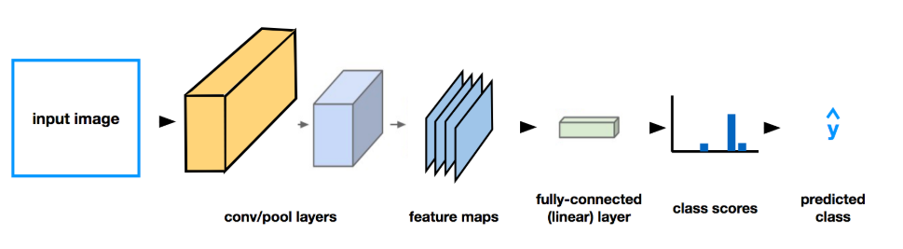
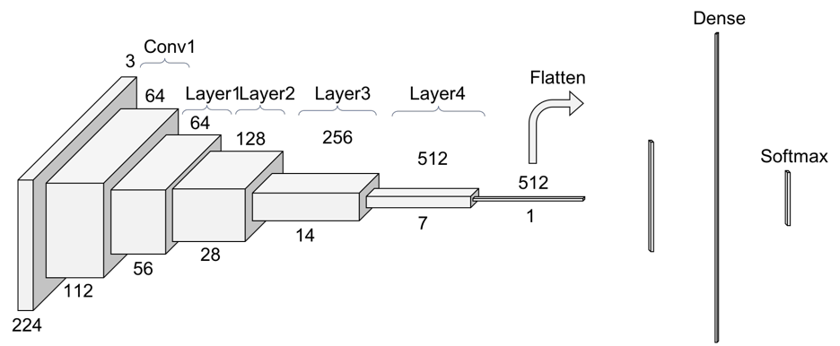

Slide 9
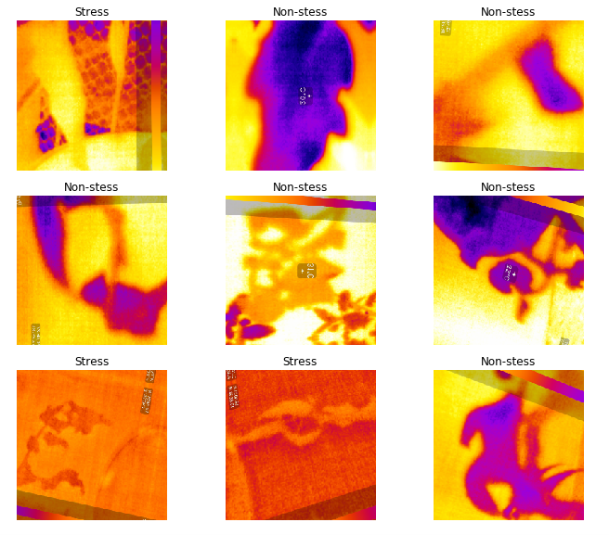
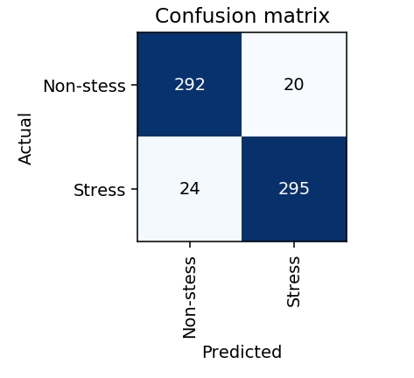

Slide 10
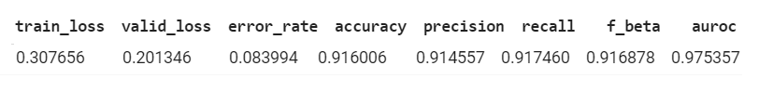
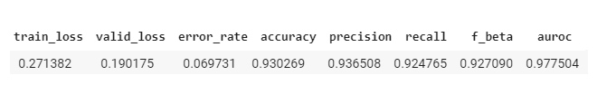
Results

Slide 11
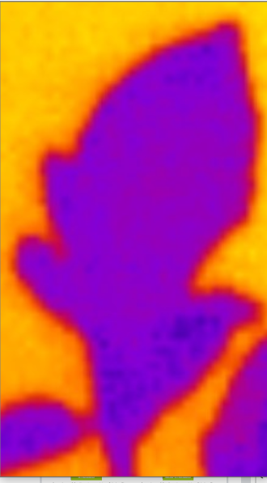
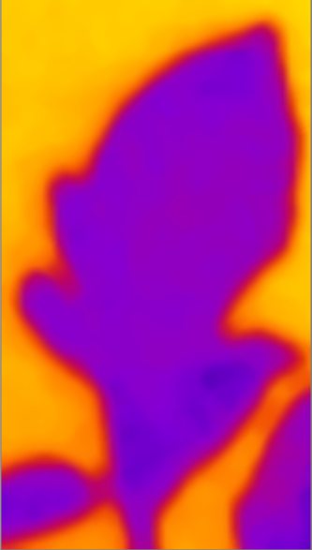
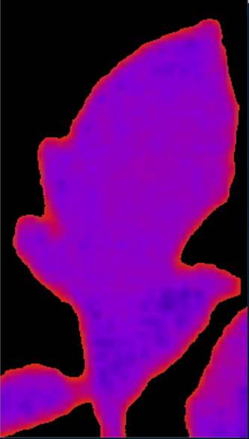
Thermal Image Pre-Processing
Original Input Image
Image after Noise Reduction
(FastN1MeansDenoising)
Foreground Extraction
(Image Thresholding)

Slide 12
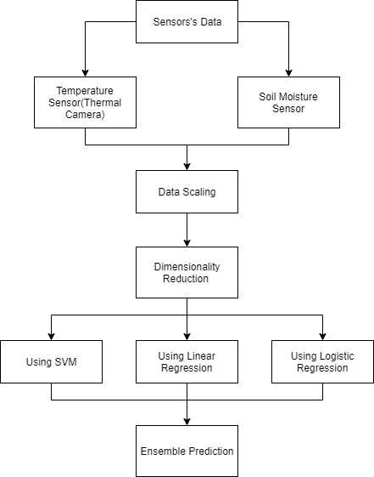
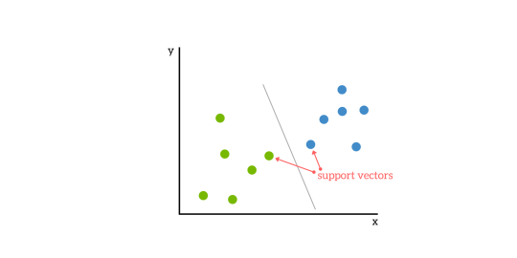

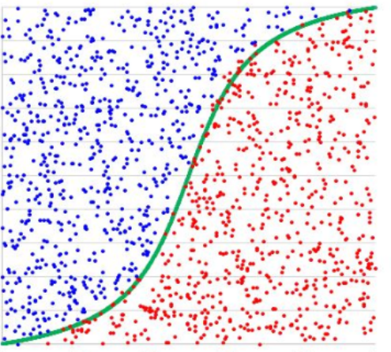
Machine Learning
SVM
Linear Regression
Model
Logistic Regression

Slide 13
Temperature Readings
T(Canopy) | T(Dry) | T(Wet) | CWSI | Result
32 | 34 | 30 | 0.5 | Non-Stressed
33 | 33 | 29 | 1 | Stressed
35 | 36 | 28 | 0.875 | Stressed
In Degree Celsius

Slide 14
Conclusion
Along with the temperature variations data and the thermal images used for feature extraction we demonstrated for the first time using a combination of both numeric as well as thermal image data on tomato plants.
It is an important step forward in the direction of automating the process of stress detection and helping farmers in further increasing the yield of the crops by reducing the amount of damage done to the plants due to stress.
One of the problems faced while doing this project is scarcity of thermal imaging data of plants so working on further increasing our dataset.

Slide 15
THANK YOU
.

